Slide 1
Discover Your Strengths
Subtitle

Slide 2
Learn where you best fit
What you would most like to do or have an effect on?
Gift – WHAT you will do (your strengths)
Where do you desire to make a difference?
Call – WHERE you will make a difference
Personality – HOW it will look
Photo via Pixabay

Slide 3
Motivational Gifts
Perceiver
Teacher
Encourager
Server
Giver
Ruler
Mercy
Speaking gifts
Intrinsic motivations or tendencies that make each person unique. Listed in Romans 12 of the Bible.
Doing gifts
Photo via Pixabay

Slide 4
Motivational Gifts
Knowledge of the gifts enables one to:
Discover their strengths
Know what career or jobs best fit their gifts
This contributes to a sense of well-being and allows you to be where you feel most effective, self-motivated, and satisfied.
Photo via Pixabay

Slide 5
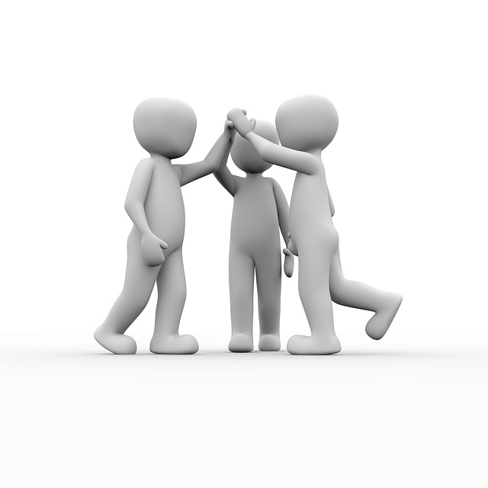
Motivational Gifts
Identifying gifts in others enables one to:
Understand how to motivate different people
Understand the “why” behind someone’s likes and dislikes
Results in better interpersonal relationships
Photo via Pixabay

Slide 6
Gifts vary within your lifetime
We each have 2 or 3 gifts called a “gift mix” or profile
During our lifetime, our gift mix varies depending on:
Different roles in life
Different occupations (career changes)
Different relationships (son or daughter versus parent, grandparent)
Different times of life (school, work, retirement)

Slide 7
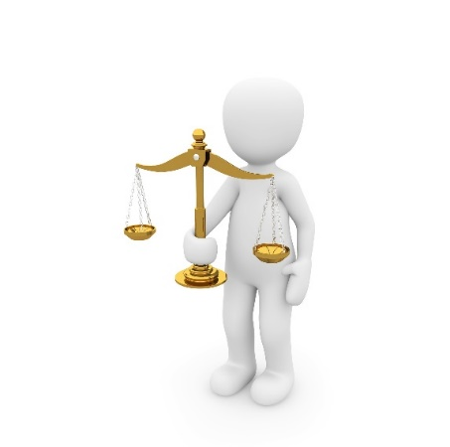
Perceiver
Ability to reveal information to help others, keen discernment and sense of right and wrong
Desire to “stand up for what is right”and intense disdain for injustice
Tend to see things in “black and white” with no gray areas. High integrity, values truth.
Can become passionate about a principle or cause – having the right message but too zealous in their presentation. Perceivers are bold and will confront.
Tend to be private individuals due to introspective nature. Can become too critical of themselves.
Photo via Pixabay

Slide 8
Perceiver
Friendships go deep, they are loyal, protective individuals
Problem solvers, they can “see” what is wrong in people and situations. This can make them appear critical or pessimistic of others when their gift is not understood.
Enjoys the challenge of solving tough issues/problems
Creative, inventive, often entrepreneurial
Gifted for advisory roles, advocating, public speaking, legal occupations, and the arts

Slide 9
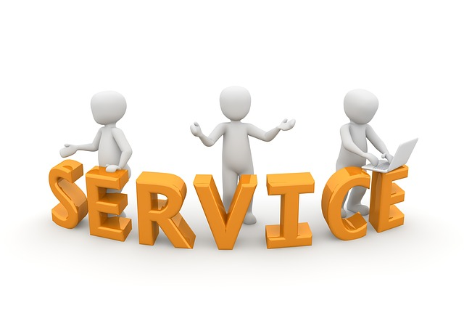
Server
Particularly skilled to identify tasks or resources needed and plans ahead to meet needs
Motivated by helping someone else
Prefer to accomplish tasks without an audience
See needs “behind the scenes” as essential to making things work on the “front lines”
Efficient, keeps things moving
Attends to detail, works with excellence,
Excels at achieving short term goals
Photo via Pixabay

Slide 10
Server
Completes tasks on time
Prefers to assist rather than lead out in the forefront
Self starters, organized
Cooperative versus competitive
Shows loyalty in actions versus words
Natural event planners, assistants, retail managers, hotel and food management, nursing, and various supportive roles

Slide 11
Teacher
Uses sound, rational, instructive reasoning to help others to learn
Natural ability to present difficult concepts in ways that are easy to understand
Concerned with presenting truth in a logical way
Needs to know reasoning behind concepts or ideas, does not take things at “face value”
May appear argumentative when trying to gain further, deeper understanding
Consummate debaters
Photo via Pixabay

Slide 12
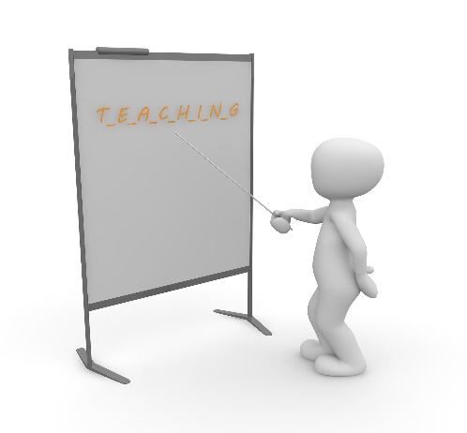
Teacher
Speaking gift, comfortable speaking/teaching others and usually in front of groups
Needs intellectual stimulation, gets bored with routine tasks
Motivated by helping others learn and grow in understanding and competency
Tends to be skilled researchers
Usually avid readers, excellent students
Good in think tanks, R&D, teaching professions, curriculum design, educational roles such as guidance counselor, and program directors.

Slide 13
Encourager
Ability to call forth the best in others through encouragement and motivation
Speaking gift, usually an extraverted individual
Likes to give practical advice and see people improve and succeed
Gregarious personality
Large circle of friends and acquaintances
Well liked
Avoids conflict and confrontation
Photo via Pixabay

Slide 14
Encourager
Tends to have a charismatic personality
Usually has influence with many people
Often finds themselves in leadership positions by default
Optimistic, positive outlook
Master communicators
Common gifting for leaders, dancers, singers, performers, show hosts, coaches, networking roles, interviewers/journalists, motivational speakers, and salespeople.

Slide 15
Giver
Characterized by a charitable, generous attitude
Donates time, money, energy to assist others in practical ways
Motivated by knowing what they gave brought aid or joy to another regardless of whether the recipient knew the source or not.
Tends to be frugal, manages their own finances well
Usually has a talent to make and save money
Industrious
Photo via Pixabay

Slide 16
Giver
Sometimes entrepreneurial in their thinking
Effective in positions that require financial or mathematical proficiency such as budgeting, accounting, financial planning, accounts payable, or handling finances for organizations in some way.
Their generous attitude often draws them into hospitality and/or customer service roles and enables them to go above and beyond to satisfy customers.
When patience and generosity of others runs out, a true givers continue to be gracious.

Slide 17
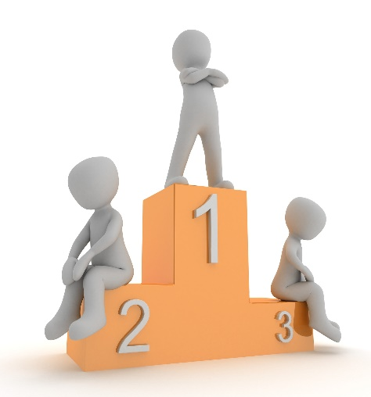
Ruler
Motivated to lead others to accomplish a common goal and succeed.
Sees the “big picture”
Looks ahead for possibilities, obstacles, and guides others to a successful completion.
Take charge, assertive nature. May appear bossy when their gift is not understood.
Comfortable being in authority
An ability to bring order by setting up structures, systems, methods for others to follow.
Photo via Pixabay

Slide 18
Ruler
Resembles behaviors of the other gifts
Like Perceivers, Rulers warn of upcoming possibilities or obstacles
Like Teachers, Rulers use sound and rational counsel to convince others of the common goal
Like Encouragers, Rulers inspire others to improve and succeed
Like Servers, Rulers tend to be task driven
Unique to a Ruler is the motivation to be in charge
Rulers do well in management positions, not always leadership positions. Effective as managers within a larger organization. Skills work well in consulting and advisory roles.

Slide 19
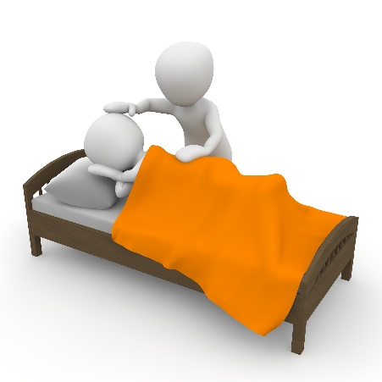
Mercy
Motivated to relieve suffering of others, show empathy, and bring comfort
Like Perceivers, Mercy gifts are concerned about injustice because of the desire to help the victims of injustice.
Enables one to extend patience and grace to others for longer periods of time than other gifts
Tender-hearted and people focus versus task focus
Needs to be aware of their sensitive nature, feelings hurt easier than other gifts.
Avoids conflict and confrontations
Photo via Pixabay

Slide 20
Mercy
Less likely to become frustrated when people repeatedly come to them with problems, unlike those gifted in other areas.
Good fit for human resource departments where employee concerns are addressed.
Must understand the need to set personal boundaries so they do not get burned out with problems of others.
Often effective in hospitality roles where bringing comfort is needed.
Mercy gifts tend to be gifted in the creative arts
Good fit for roles that require compassion such as nursing, working with children, physical therapists, counselors.

Slide 21
Learn where you best fit
Are you doing what you were created for?
Are you using your strengths?
Discovering your gifts will enable you to seek out opportunities where you feel the most comfortable, effective, and personally satisfied.

